Slide 1
Agile Development
Cris Ann Rioflorido
DEV-COL Team Leader / Software Developer
Stephen Joe Cruz
DEV-COR Deputy Team Leader / Associate Software Developer

Slide 2
Agile Development
Agile development describes a set of principles of software development under which requirements and solutions evolve through the collaborative effort of customer and development team.

Slide 3
Agile Manifesto
We are uncovering better ways of developing software by doing it and helping others do it. Through this work, we have come to value:
Individuals and interactions over processes and tools
Working software over comprehensive documentation
Customer collaboration over contract negotiation
Responding to change over following a plan
That is, while there is value in the items on the right, we value the items on the left more.

Slide 4
The principles of agile methods
Principle | Description
Customer involvement | Customers should be closely involved throughout the development process. Their role is provide and prioritize new system requirements, and to evaluate the iterations of the system.
Incremental delivery | The software is developed in increments with the customer specifying the requirements to be included in each increment.
People not process | The skills of the development team should be recognized and exploited. Team members should be left to develop their own ways of working without prescriptive processes.
Embrace change | Expect the system requirements to change and so design the system to accommodate these changes.
Maintain simplicity | Focus on simplicity in both the software being developed and in the development process. Wherever possible, actively work to eliminate complexity in the system.

Slide 5
Scrum
It is an Agile Software development method for project management
Characteristics:
Prioritized work is done.
Completion of backlog items
Progress is explained

Slide 6
Scrum has been used by:
•Microsoft
•Yahoo
•Google
• Electronic Arts
•IBM
• Lockheed Martin
• Philips
• Siemens
•Nokia
• Capital One
• BBC
•Intuit
•Apple
•Nielsen Media
• First American Corelogic
•Qualcomm
•Texas Instruments
• Salesforce.com
•John Deere
• Lexis Nexis
• Sabre
• Salesforce.com
•Time Warner
•Turner Broadcasting
• Oce

Slide 7
Scrum has been used for:
• Commercial software
• In-house development
• Contract development
• Fixed-price projects
• Financial applications
• ISO 9001-certified applications
• Embedded systems
• 24x7 systems with 99.999% uptime requirements
• the Joint Strike Fighter
• Video game development
• FDA-approved, life-critical systems
• Satellite-control software
• Websites
• Handheld software
• Mobile phones
• Network switching applications
• ISV applications
• Some of the largest applications in use

Slide 8
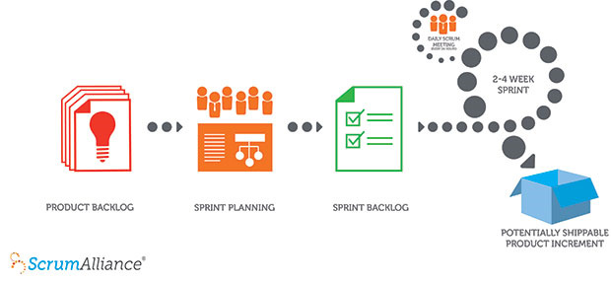
Scrum

Slide 9
Sprints
Scrum projects make progress in a series of “sprints”
Typical duration is 2–4 weeks or a calendar month at most
A constant duration leads to a better rhythm
Product is designed, coded, and tested during the sprint

Slide 10
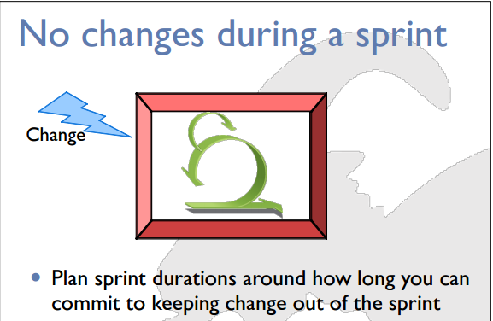
Sprints

Slide 11
Scrum framework
Roles
Ceremonies
Artifacts
Product Owners
Scrum Master
Team
Sprint Planning
Sprint Review
Sprint Retrospective
Daily Scrum Meeting
Product backlog
Sprint backlog
Burndown Charts

Slide 12




Roles and Responsibilities
Product Owner
Scrum Master
Development Team
Stakeholders

Slide 13
Product Owner
Define the features of the product
Makes scope vs. schedule decisions
Responsible for achieving financial goals of the project
Prioritize the product backlog
Adjust features and priority every sprint, as needed
Accept or reject work results

Slide 14
The Scrum Master
Responsible for enacting Scrum values and practices
Removes impediments
Coaches the team to their best possible performance
Helps improve team productivity in any way possible
Enable close cooperation across all roles and functions
Shield the team from external interference

Slide 15
The Development team
Typically 5-9 people
Cross-functional:
Programmers, testers, user experience designers, etc.
Members should be full-time
May be exceptions (e.g., database administrator)
Teams are self-organizing •
Ideally, no titles but rarely a possibility •
Membership should change only between sprints

Slide 16

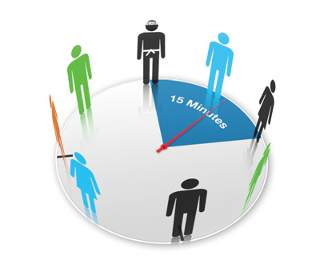


Ceremonies
Sprint Planning
Daily Scrum Meeting
Sprint Review
Sprint Retrospective

Slide 17
Sprint Planning Meeting
Who
Discuss Top Priority Product
Why
Know what will be worked on
Scrum Masters
Product Owner
Scrum Masters selects which to do
Understand it enough to do it
Agenda

Slide 18
Sprint Planning
Scrum Masters selects items from the product backlog they can commit to completing
Sprint backlog is created

Slide 19
Sprint Startup Meeting
Who
Discuss Top Priority Product
Why
Know what will be worked on
Scrum Master
Product Owner
Development team selects which to do
Understand it enough to do it
Agenda
Development Team

Slide 20
Sprint Startup
Tasks are identified and each is estimated (1-16 hours)
Collaboratively, not done alone by the ScrumMaster
High-level design is considered

Slide 21
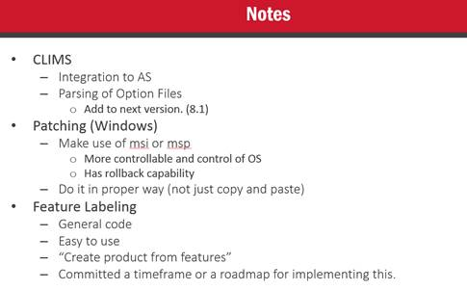
Sprint Focus

Slide 22
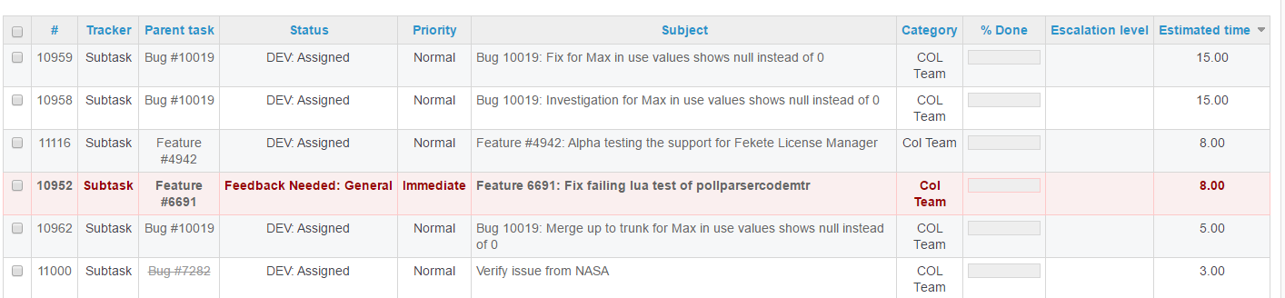
Sprint Backlog

Slide 23
Daily Scrum Meeting
Parameters
Daily
15-minutes
Stand-up (optional)
Not for problem solving
Whole world is invited
Only team members, ScrumMaster, product owner, can talk
Helps avoid other unnecessary meetings

Slide 24
Daily Scrum Meeting
Everyone answers 3 questions
What did you do?
What will you do today?
Is anything in your way?
These are not status for the Scrum Master.
They are commitments in front of peers.

Slide 25
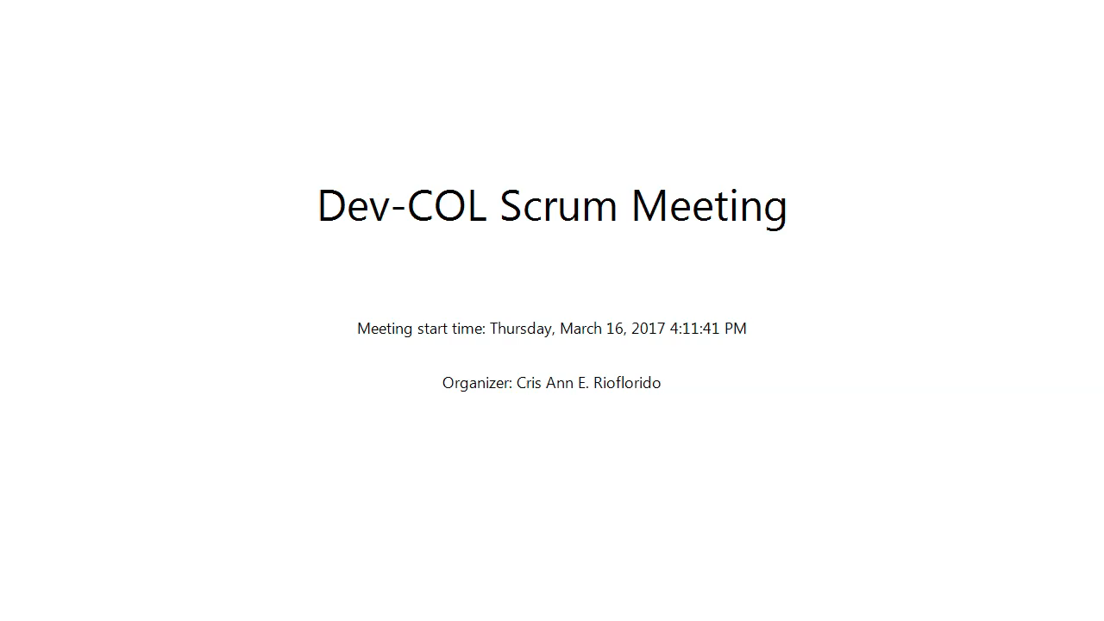
Daily Scrum Meeting

Slide 26
Sprint Review
Team presents what it accomplished during the sprint
Typically takes the form of a demo of new features or underlying architecture
Informal
2-hour prep time rule
No slides
Whole team participates
Invite the world

Slide 27
Sprint Retrospective
Periodically take a look at what is and is not working
Typically around 30 minutes
Done after every sprint
Whole team participates
Scrum Master
Product owner
Team
Possibly customers and others

Slide 28
Sprint Retrospective
Start / Stop / Continue
Whole team gathers and discusses what they’d like to:
This is just one of many ways to do a sprint retrospective.
Start Doing
Stop Doing
Continue Doing

Slide 29
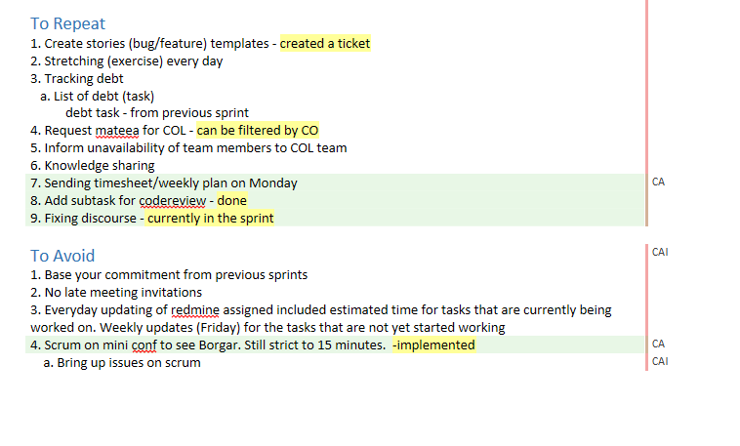
Sprint Retrospective

Slide 30
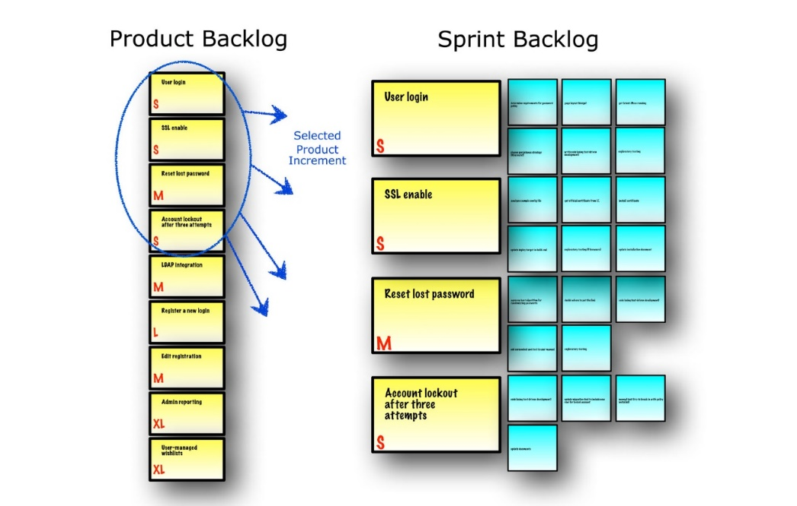
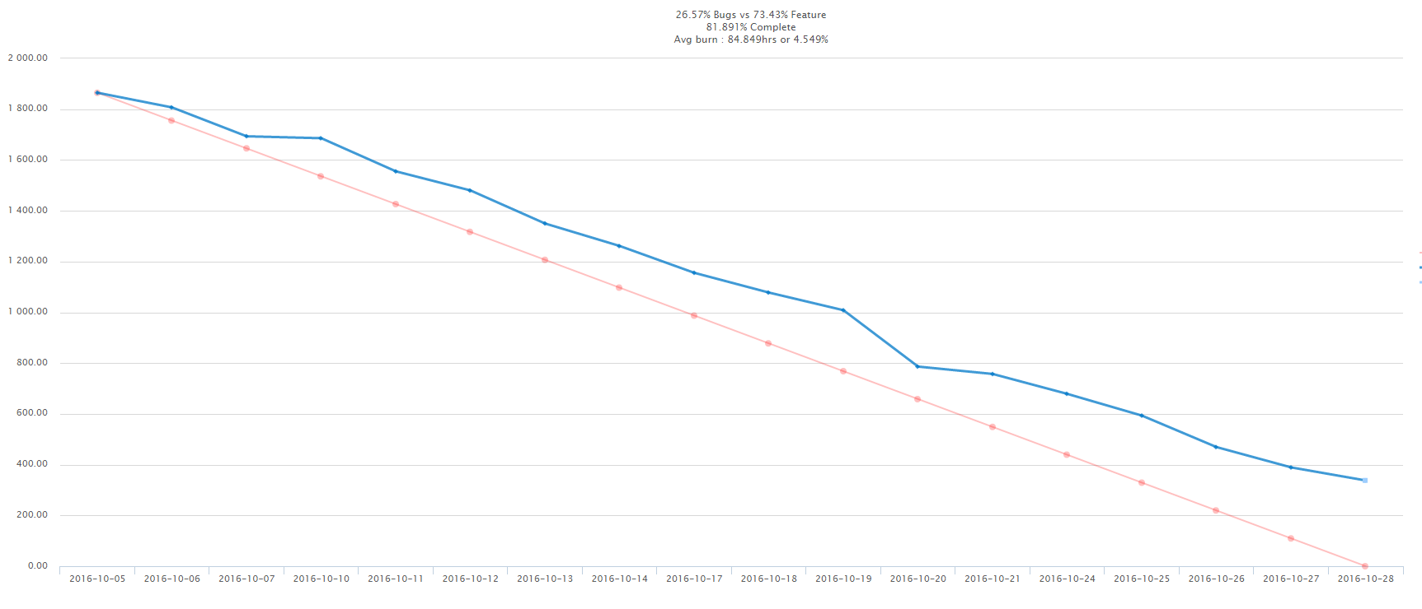
Artifacts
Burndown Chart

Slide 31

Product Backlog
The requirements
A list of all desired work on the project
Ideally expressed such that each item has value to the users or customers of the product
Prioritized by the product owner
Reprioritized at the start of each sprint

Slide 32
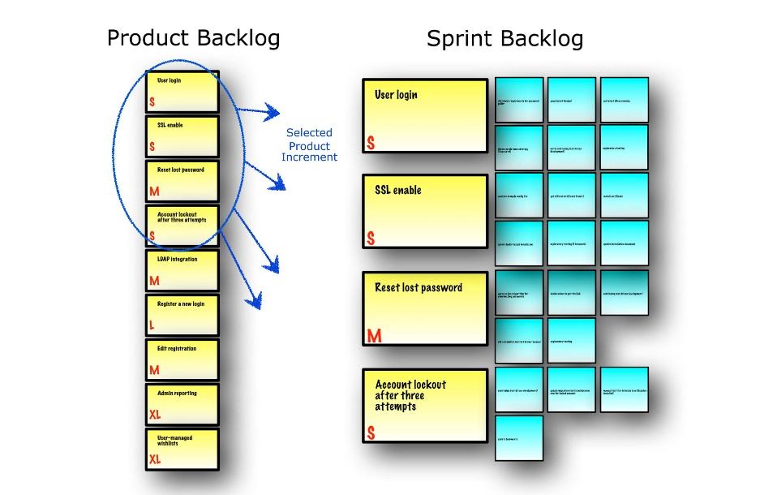
Sprint Backlog
Sprint Goal
A short statement of what the work will be focused on during the sprint.
April Sprint:
Version 8 Beta
Bug Fixing,
Fekete License Manager Support
February Sprint:
Upgrade patch 7.0.5
Dongle Support, CLIMS, Bugs

Slide 33
Managing the sprint backlog
Individuals sign up for work of their own choosing
Estimated work remaining is updated daily
Any team member can add, delete or change the sprint backlog
If work is unclear, define a sprint backlog item with a larger amount of time and break it down later
Update work remaining as more becomes known

Slide 34
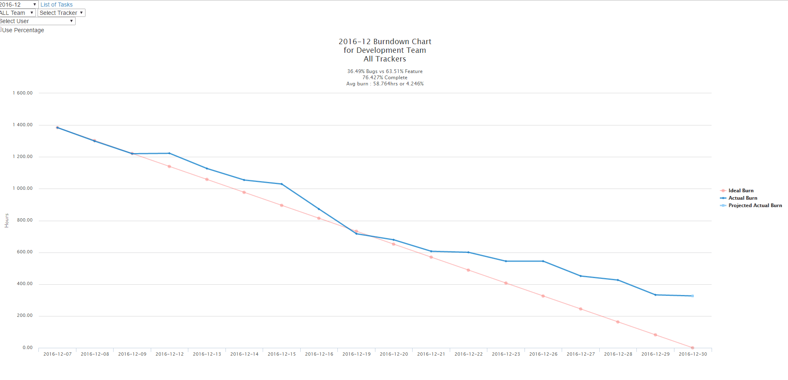
Sprint Burndown Chart

Slide 35
Development Tools

Slide 36
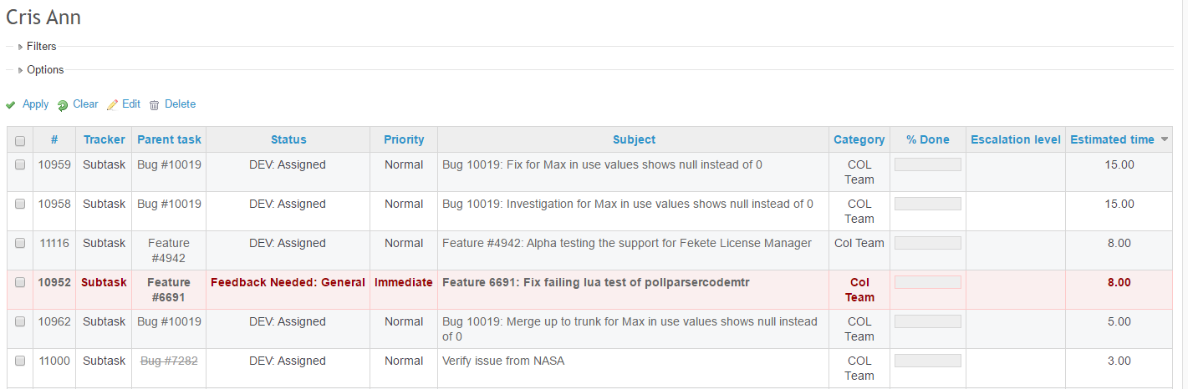
Redmine

Slide 37
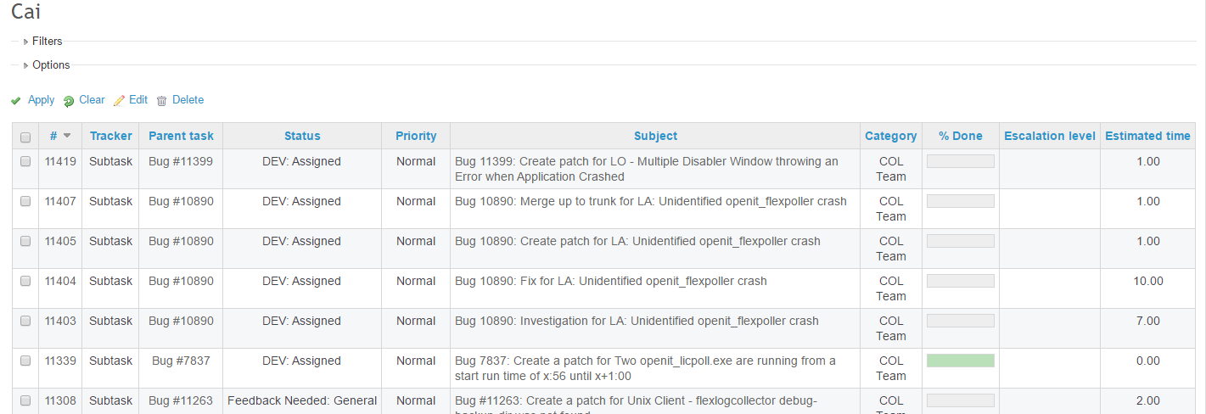
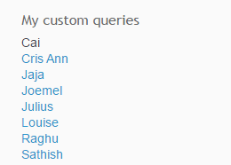
Redmine

Slide 38
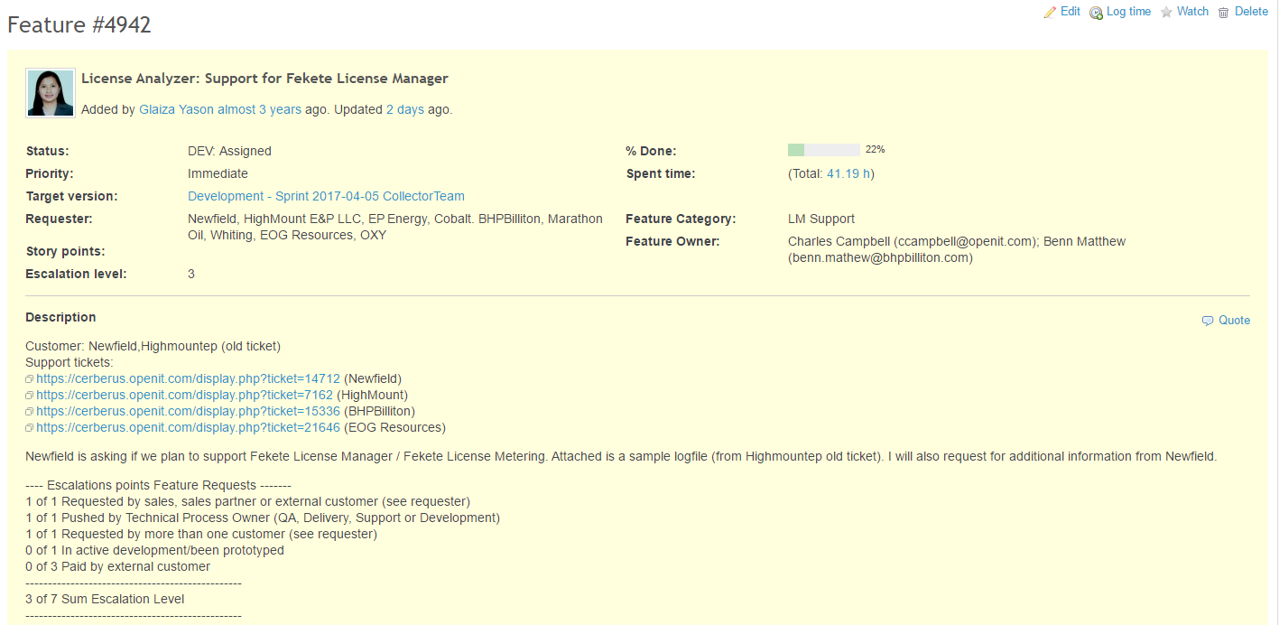
Redmine

Slide 39
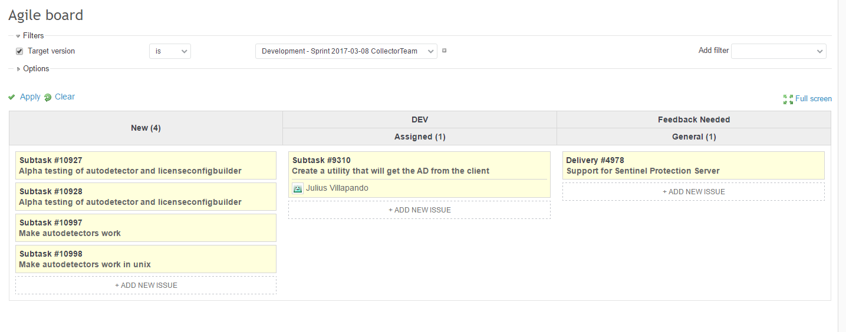
Redmine Agile Board

Slide 40
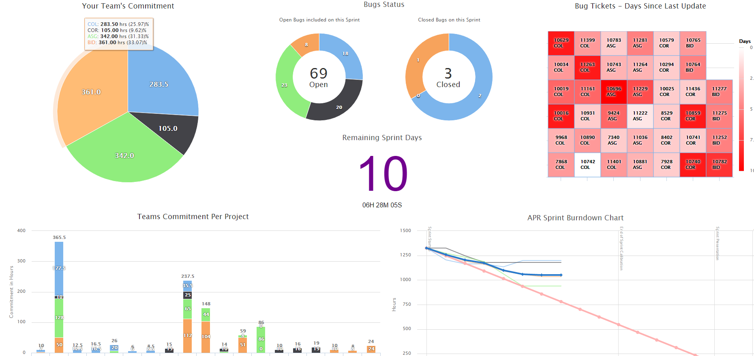
Mateea (Internal Tool)

Slide 41
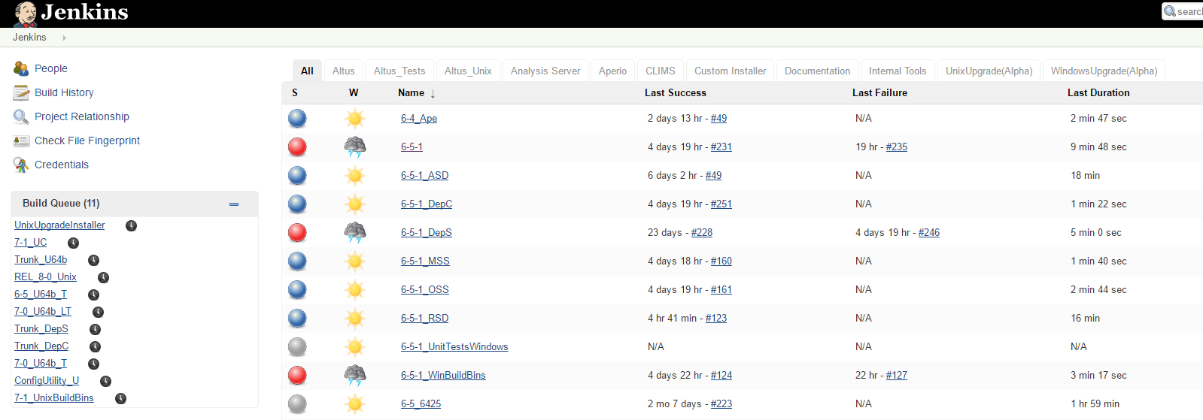
Jenkins

Slide 42
Team Tasks’ Delegation
Front-end/GUI
Back-end (C++ Development Team)
Business Intelligence side
Technical and General Documentation
Build and Integration
QA

Slide 43
Version control
This is the management of changes to all files involved in development, including but not limited to:
source codes
scripts
documentations
Examples of version control systems are:
CVS (Concurrent Versioning System)
SVN (Subversion)
Git (Either Github or Gitlab)
Notes:
Next slides will consist of screenshots for the different version control systems, starting with CVS.

Slide 44
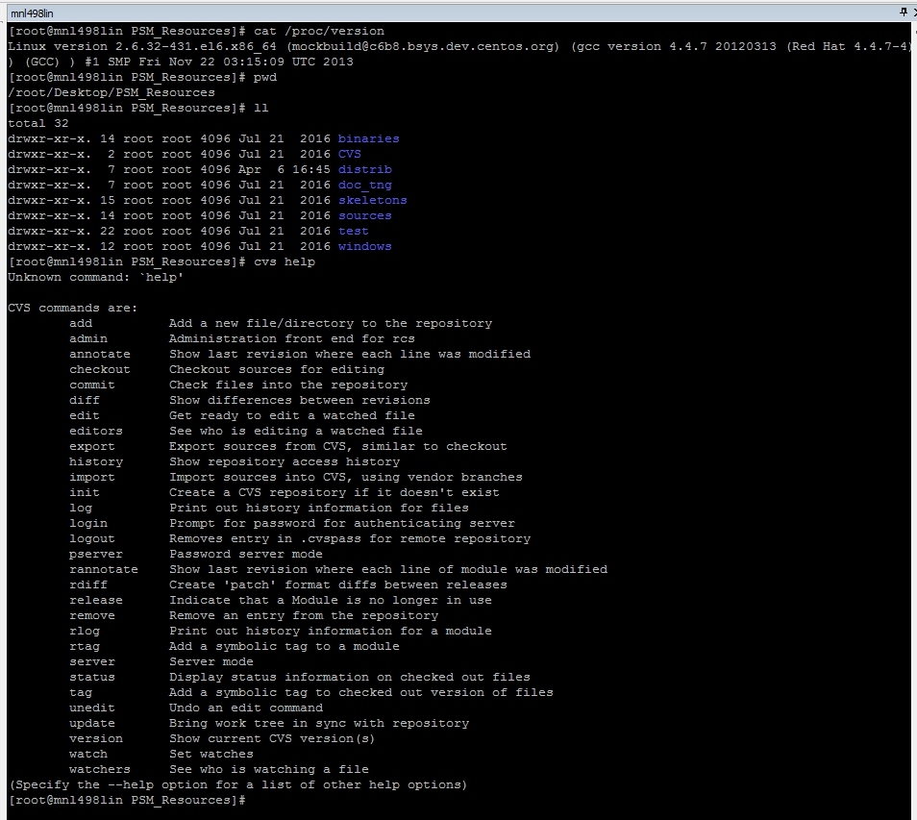
CVS commands screenshot from a Linux terminal, accessed through MtPuTTY SSH
Notes:
Next slide will be SVN commands screenshot.

Slide 45
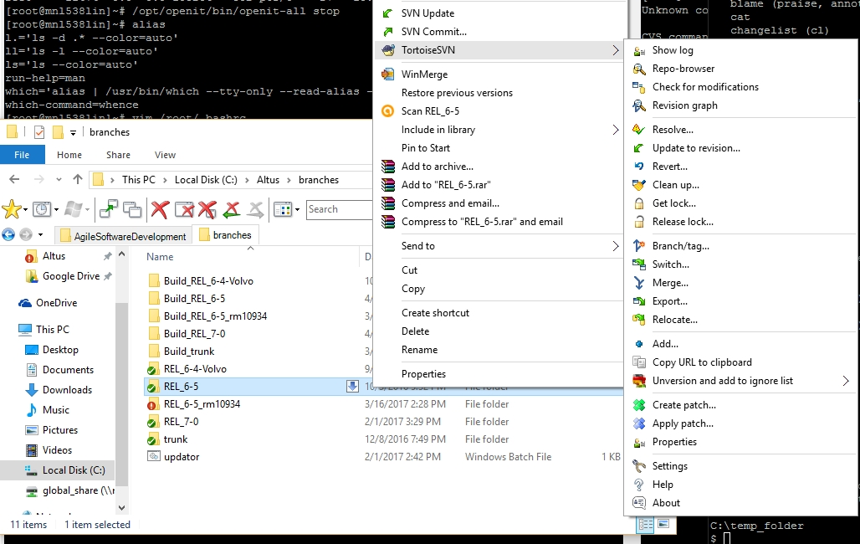
SVN commands screenshot from Windows file explorer, where TortoiseSVN is integrated in the context menu
Notes:
Next slide will be SVN logs screenshot.

Slide 46
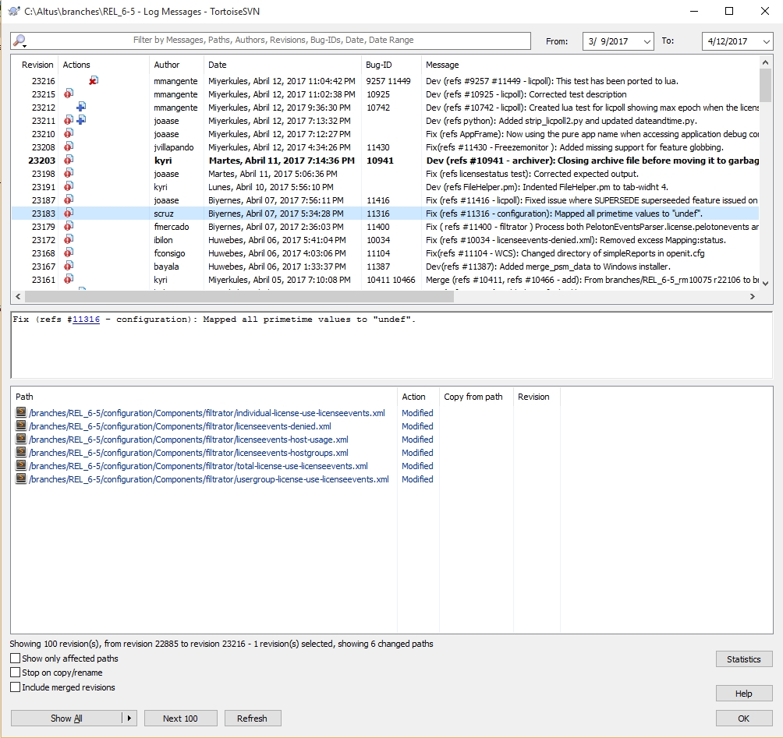
SVN logs screenshot, seen after clicking the “Show logs” command from the TortoiseSVN context menu
Notes:
Next slide will be screenshot of Git bash.

Slide 47
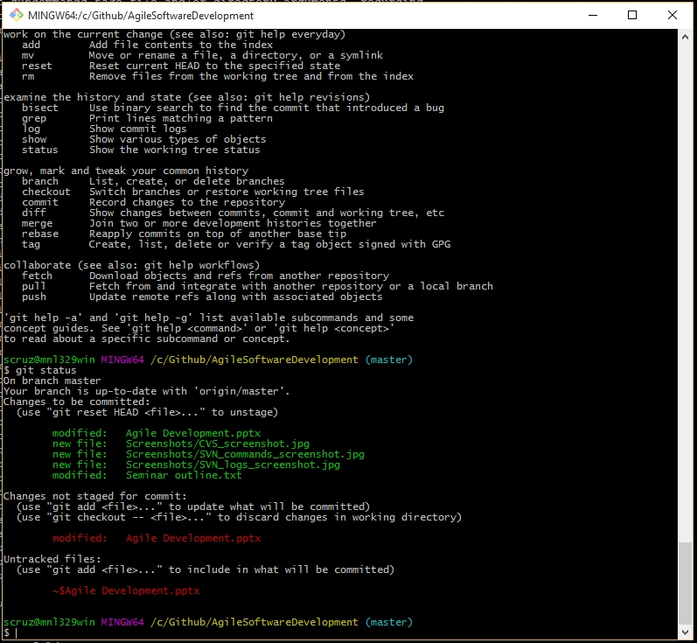
Git bash screenshot; current directory is inside the cloned repository’s local working copy
Notes:
Next slide will be common commands in version control systems and what they do.

Slide 48
Frequently used version control systems’ commands (using the CLI):
To obtain a working copy of the repository:
CVS and SVN -> checkout <URL of repository>
Example -> svn checkout http://svn/repos/altus/branches/REL_6-5
Git -> clone <URL of repository>
Example -> git clone https://github.com/joeypencil/Joeyjava.git
To check logs of revisions:
CVS and SVN -> log <branch> [--limit <number of revisions>]
Example -> svn log REL_6-5 --limit 3
Git -> log [-<number of revisions>]
Example -> git log -5
To commit your changes from the local working copy to the repository:
CVS, SVN and Git -> commit –m “<Commit message here>” [specific files, for selective commit only]
Example -> svn commit –m “Fixed regex for validation”
Notes:
Next slide is continuation of commands.

Slide 49
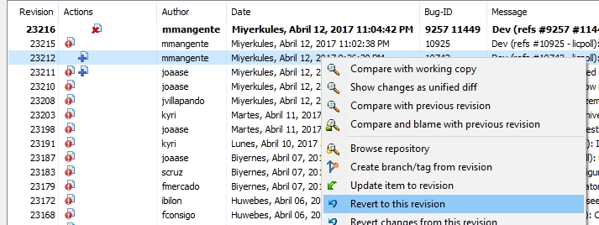
When merging changes from one branch to another, it is better to use a diff software to merge the differences easily, rather than using the CLI. This also goes for reverting to an older revision.
To update your working copy:
CVS and SVN -> update <branch>
Example -> svn update REL_7-0
Git -> pull
Example -> git pull
Notes:
This is the last slide for version control commands. Next slides will be about Release management process.

Slide 50
Release management process
This is the process of handling software releases through different stages and environments, which include testing, fix merging, building, release note documentation, and distribution to customers.
Most software development companies deploy their product in these forms:
Patches
Upgrade packages
Major releases
Do note that, for a major version, it is highly advisable to stick to one deployment method. A single major version that uses more than one deployment method can have dire consequences in the long run, in terms of version control and issue tracking.
Notes:
Next slide will be a screenshot of the patch page.

Slide 51
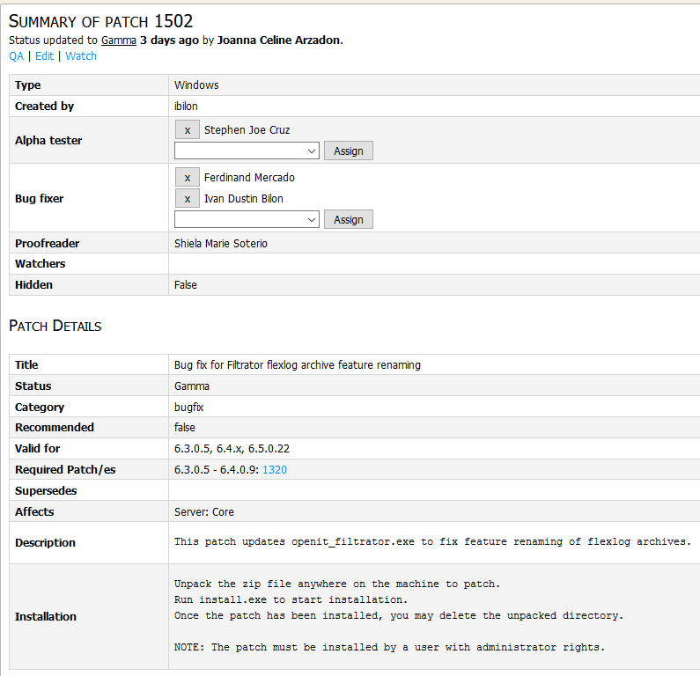
Patches are deployed as a lightweight solution for fixing particular bugs, but can also serve as a medium for deploying features.
Before a patch is released to the customer, it must undergo a series of tests first in different environments (varying operating systems, stress tests, case-to-case testing, etc.).
The downside of a patch deployment system is that there must be careful consideration of versions where they are compatible, especially where there is quite a difference in major version number.
Notes:
Next slide will be screenshot of upgrade package download page.

Slide 52
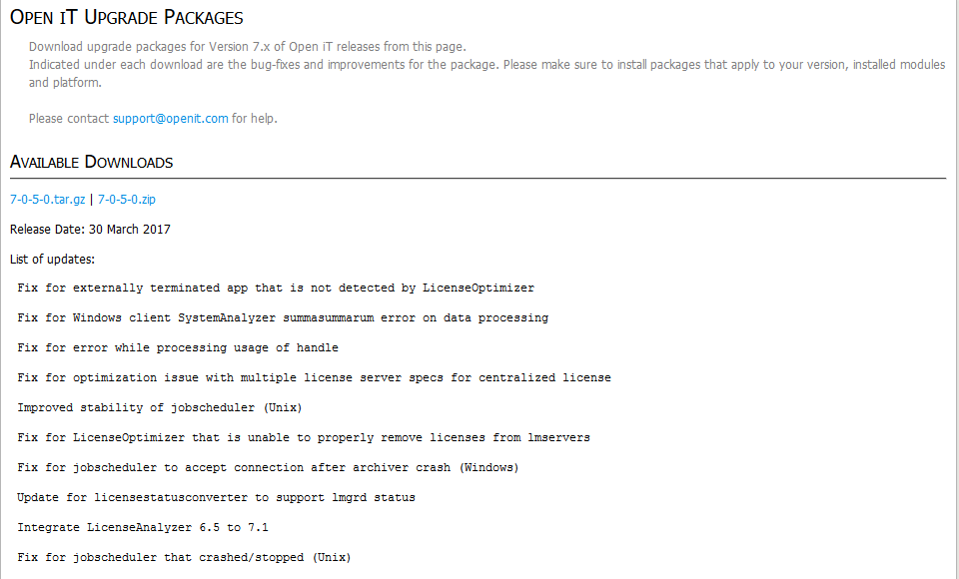
Upgrade packages, on the other hand, are more like bigger patches, which contain more than one bug fix, and are therefore expected to modify a greater number of binaries and/or files.
An advantage for this setup is that multiple issues can be fixed for a customer even before they encounter most of the listed issues. Also, installation of upgrade packages are linear, so issue tracking is a lot easier.
The only disadvantage is that, if a customer fails to install a lot of upgrade packages, he will have to install a lot of the packages when he finally decides to upgrade.
Notes:
Next slide will be screenshot of major releases in the Network-Attached Storage.

Slide 53
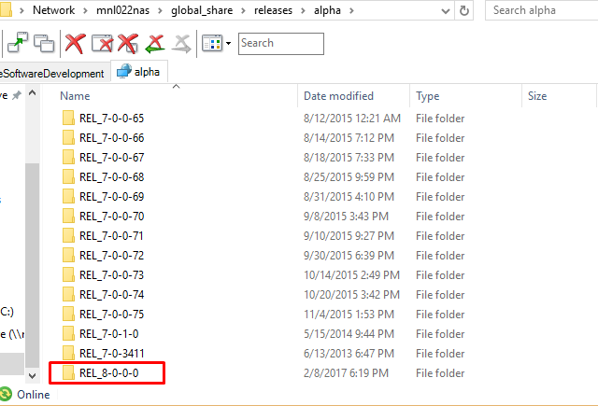
Major releases are deployed in the form of installers. It is expected that bug fixes from lower versions are already included in the proceeding major release.
The installers are expected to handle “upgrading”. This means that there is no need to uninstall the current installation of the product just to be able to install the latest major release (at least explicitly).
Do note that not all features that are in the lower versions are to be expected in the proceeding major release, since there may be changes in the frameworks used that would make previously-existing features unstable.
Notes:
Next slides will be about Software testing.

Slide 54
Software Testing
This is the process in which software programs are executed on various environments to see if they would accomplish the expected task, given the conditions of the setup. Aside from the test of completing its objective, there are also tests that determine the flexibility of the program, such as:
Stress tests – Provides a heavy load of input data for the program to process. This test is usually done to check for memory leaks, and monitor resource usage of the program under strenuous load.
Compatibility tests – This is used to check if the program will still accomplish its task when it is placed in an uncommon scenario. This is done by using different operating systems (or different distributions thereof), and also varying system types.
Selenium tests – This is commonly done in web development. Selenium tests simulate different actions that are done to the web page, and provide information on how the web page reacts to those events.
The aforementioned tests are more commonly done by QA people. We will discuss the tests done in the development side, which are:
Unit tests
Regression / Component tests
Integration tests
Notes:
Next slide is description of unit tests.

Slide 55
Unit tests
A unit test is done to check the functionality of each class in a particular binary. The unit test runs the crucial functions in each class, and the actual output is compared with the expected output. A single character difference in the output comparison will cause the test to fail, so this is actually very good in making sure data processing goes as expected.
Even though very small differences cause unit tests to fail (which may seem kind of irritating at times), this is quite essential in the long run, since the smallest differences tend to destroy the entirety of a large output, especially for sensitive calculations and real-time systems.
Note that not all functions have to be included explicitly in the unit tests. If a crucial function calls a smaller-scale function, then the test for the crucial function is enough to be included in the unit test.
Notes:
Next slide is GIF of a unit test being run in VS 2005.

Slide 56
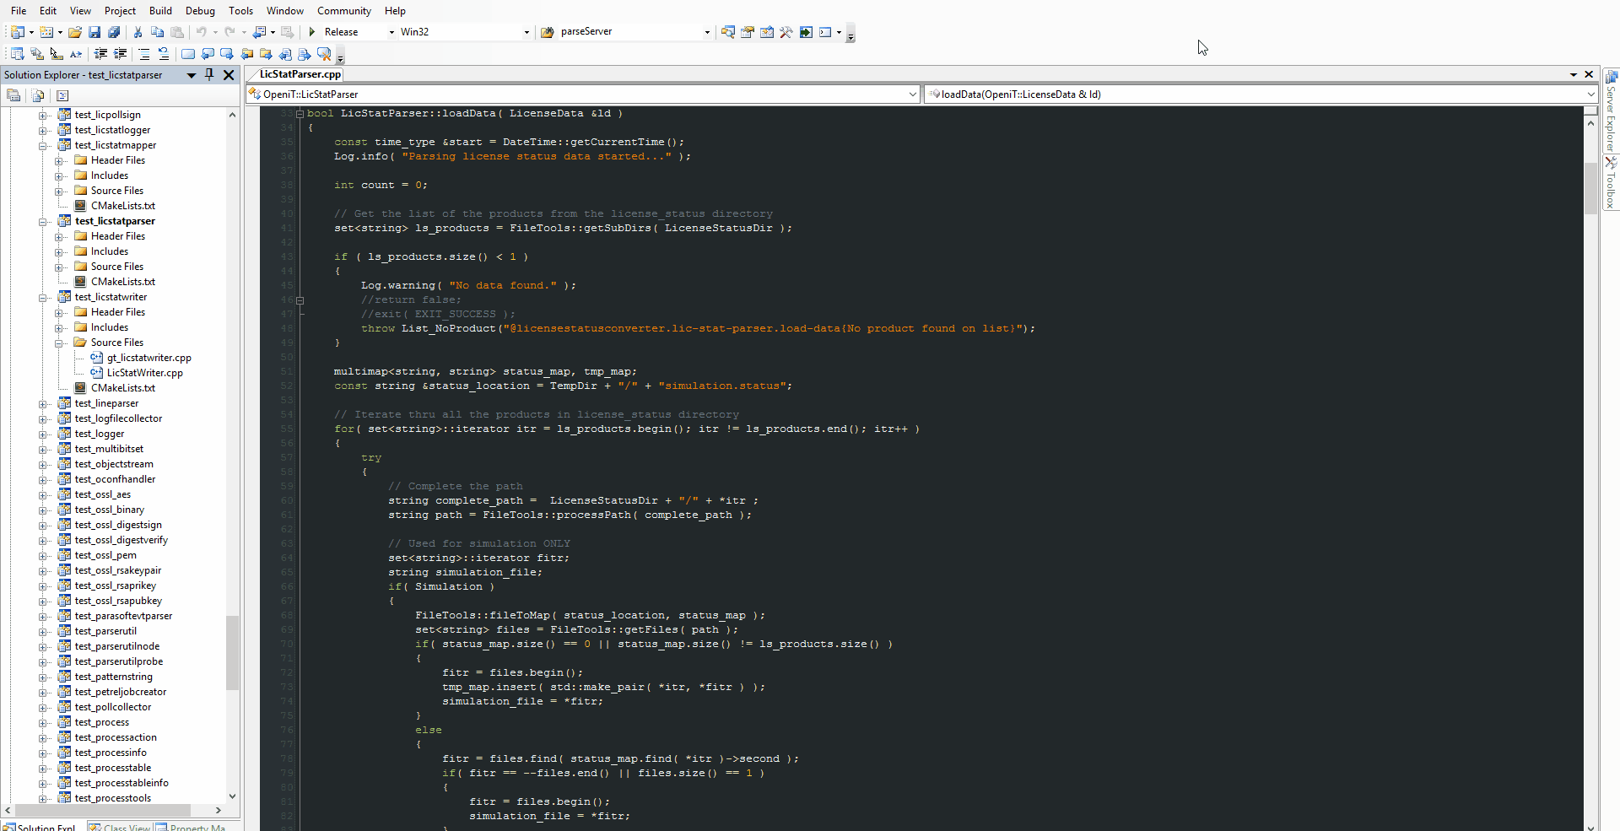
Unit test being executed in Visual Studio 2005
Notes:
Next slide is description of component tests.

Slide 57
Regression / Component test
A component test is the next level test after the unit tests. Just like the aforementioned test, there is a comparison between the actual output and the expected output, but the actual output is not the one from the classes of the binary, but the entirety of the binary is the one being put to the test.
This is also some sort of compatibility test, although the difference is that for component tests, the binary is run in the expected environment (OS and system type), although scenarios may vary (missing lines to parse in the data, different file extension for input data, etc.). Compatibility tests, on the other hand, may include executing the binary in machines where they are usually not expected (such as operating systems installed with only the CLI, some services are not installed, etc.).
Notes:
Next slide is GIF of a component test being run.

Slide 58
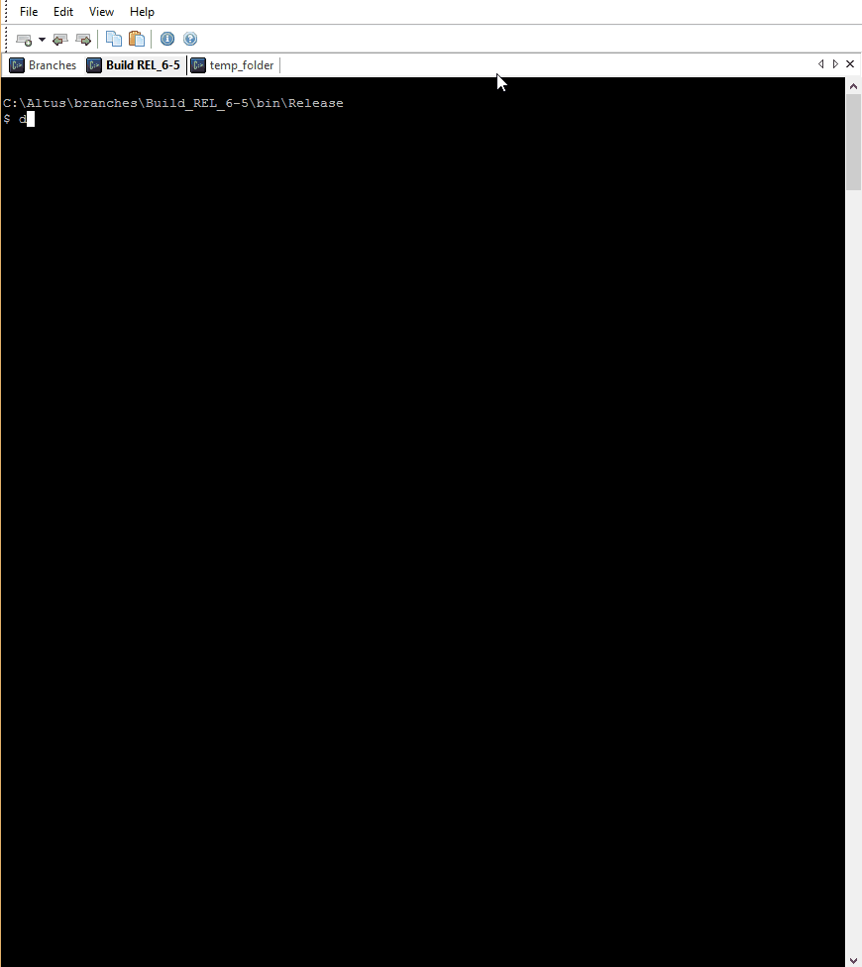
Component test being run for the licensestatusconverter binary
Notes:
Next slide is description of integration tests.

Slide 59
Integration test
Integration tests are the most common tests being done, with everything already packaged and things are run in a manner they are expected in the usual scenario. The test starts from the moment the installer runs, up to the point where there is generated information that has actual business value. In this kind of test, various stable data can be fed to the system to see if it can cater the needs of the customer, as well as trying to use the system on different machine processing capacities (lower RAM, processor speed, display resolution, etc.).
This is essentially the test that must pass before a version can move on to the next phase of the release process. Failures in the integration test that are concerned with data processing should be considered show-stoppers.
This test can take longer if a new major feature is introduced. New features tend to tackle with existing modules in a way that the general routine of data would be disturbed.
Note that even if all integration tests pass, there can be cases where one or more unit and/or component tests would fail, and at times it could be considered, depending on the scenarios covered by the tests that failed.
Notes:
Next slides will be about Communication media.

Slide 60
Communication media
Within a software development organization, it is critical that communication must be as clear and explicit as possible, to make sure things are going as planned. One wrong assumption could lead to a lot of wasted effort and time. To aid everyone in the organization regarding getting messages and ideas across, there are a lot of tools that can be used, including:
Microsoft Outlook
Skype for Business
Microsoft Teams
Notes:
Next slide will be a description of MS Outlook.

Slide 61
Microsoft Outlook
MS Outlook is an email application from Microsoft that is part of the Microsoft Office suite, although it can also be used as a personal information manager. It also includes the following modules:
Calendar
Task manager
Contact manager
Note taking journal
Outlook is set up within an organization by having an email server which has an installed Microsoft Exchange Server.
Notes:
Next slide will be a GIF of MS Outlook.

Slide 62
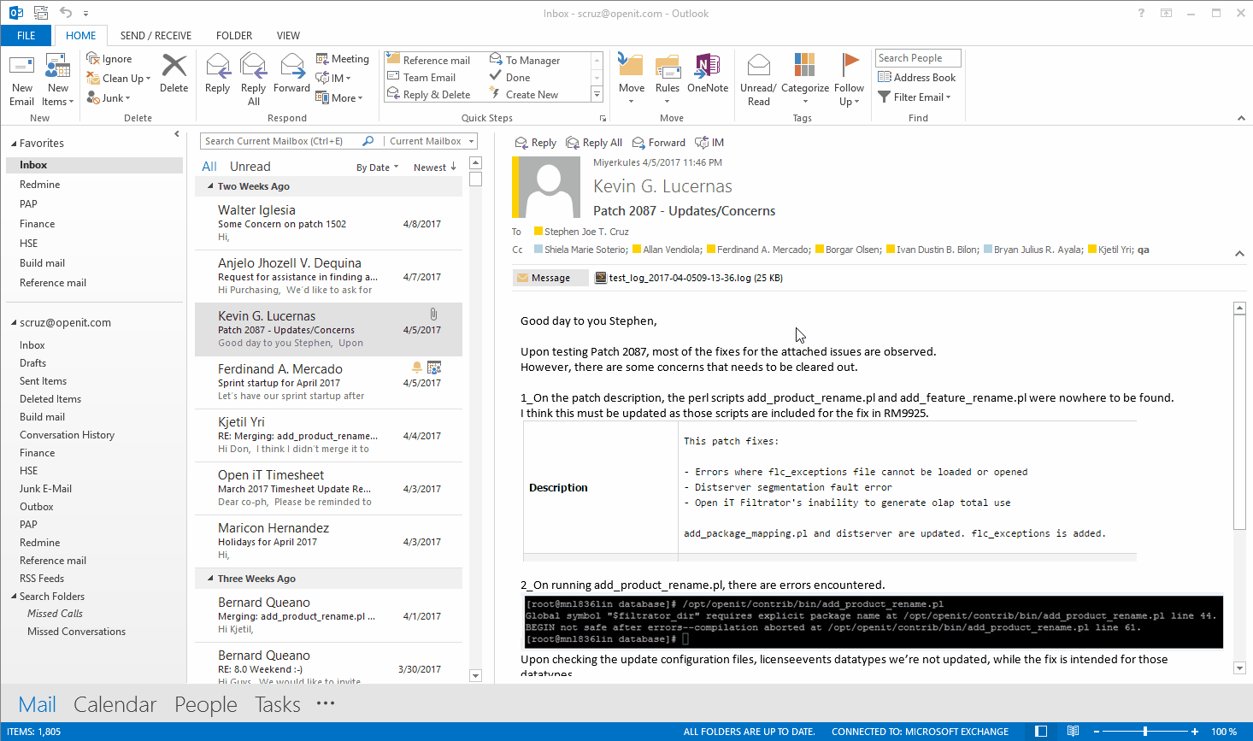
Mail and Calendar organization in Microsoft Outlook
Notes:
Next slide will be a description of Skype for Business and table of comparison with Skype.

Slide 63
Skype for Business
Skype for Business (SfB) is an office communication tool for instant messaging with colleagues and live video call appointments, which are quite the same with Skype, but with some major differences.
Feature | Skype for Business | Skype
Max number of users in a single conference call | 250 | 25
Meeting controls for presenters, meeting lobby for attendees | Available | N/A
Ability to record meetings and conferences | Available | N/A
Automatic meeting creation from Office calendar invites | Available | N/A
Notes:
Next slide will be GIF of Skype for Business.

Slide 64
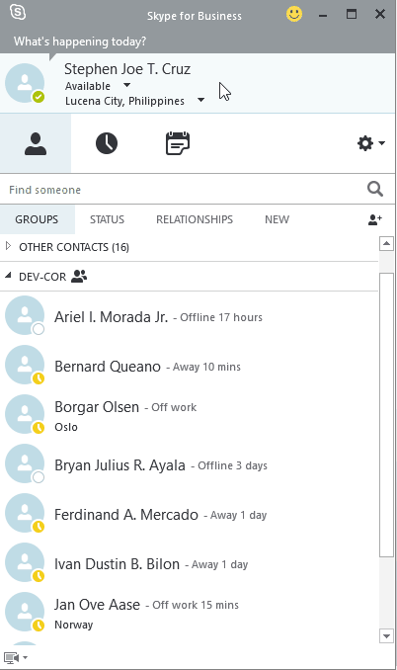
Skype for Business GUI
Descriptive status to indicate current activity, presence, and location
List of contacts and their status
History menu for previous messages and calls
List of meetings (pop ups appear some minutes earlier when a meeting is about to take place)
Notes:
Next slide will be a description of Microsoft Teams.

Slide 65
Microsoft Teams
MS Teams is a chat-based workspace in Office 365 that allows more flexible collaboration within an organization. It was launched on November 2, 2016 in Beta form, and is expected to be generally released in the 1st quarter of 2017.
It is somehow similar to Skype in terms of instant messaging, but MS Teams makes group (team) chats more organized. Within group chats are channels, which serves as a topic setting. Also, within each channel, chats are further grouped into threads, so that sub-topics don’t prolong the main group chat thread.
More good features include a Files menu where you can see all the files uploaded in MS Teams, and the ability to integrate Office apps to make external app files easier to navigate on-the-go.
Notes:
Next slide will be a GIF of MS Teams.

Slide 66
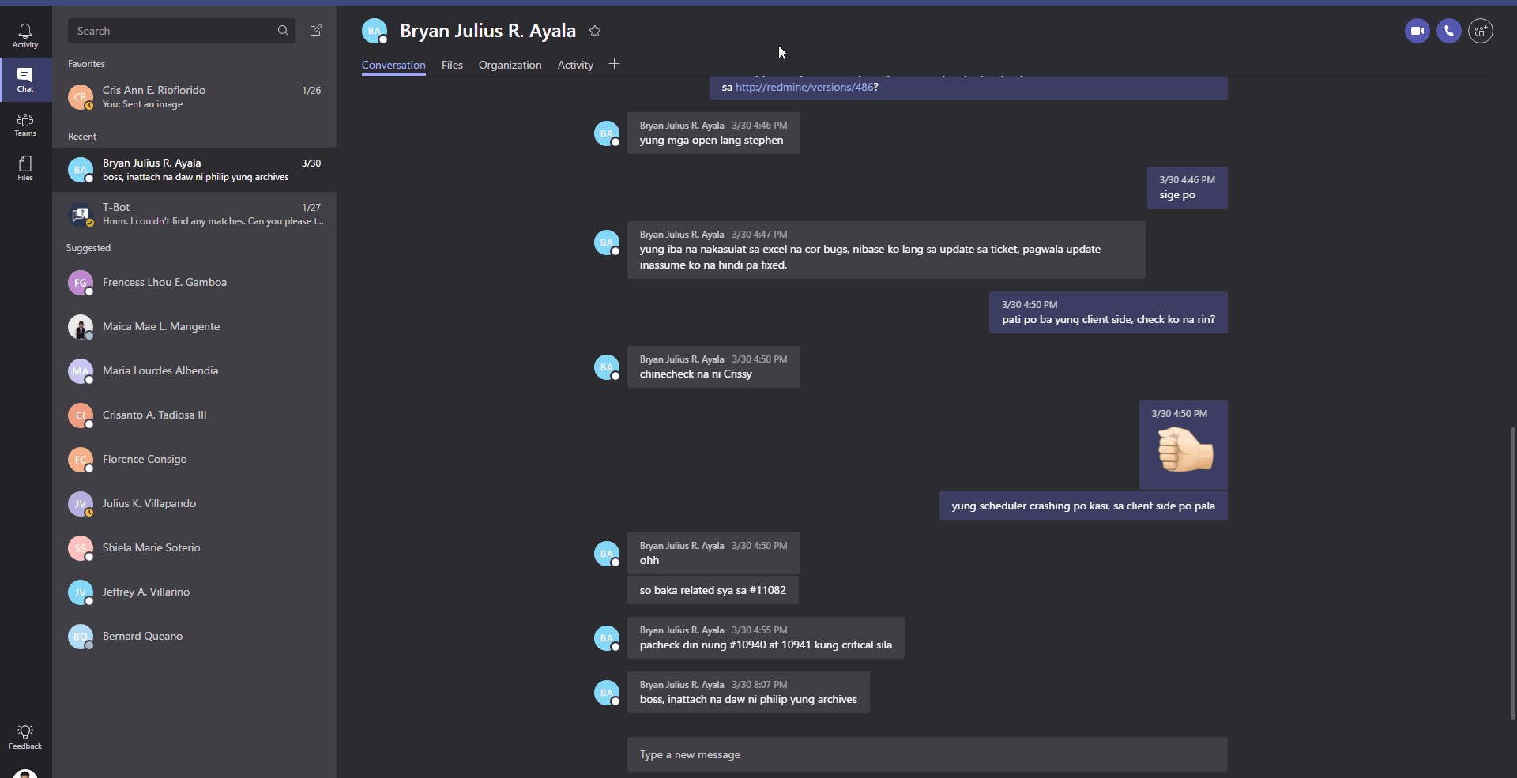
Microsoft Teams GUI and major features
Notes:
This is the last slide before the “Thank you” slide.

Slide 67
Thank you everyone for listening ☺
For inquiries, you can ask us now or send an email to:
crioflorido@openit.com
scruz@openit.com

Slide 68
Scrum Workshop

Slide 69
Scrum Meeting

Slide 70
Sprint Review

Slide 71
Sprint Retrospective Refresher
Back to back

Slide 72

Back to back
Running the activity
Instruct the participants to find a pair of similar size and weight
Ask everyone to sit on the floor, back to back with their pair
Ask the pairs to hold their arms while keeping their backs together
Tell everyone their goal is to stand up, while keeping the arms and backs together

Slide 73
Thank You! ☺
crioflorido@openit.com
scruz@openit.com

